Slide 1
FIN7830
Financial Computing with Python
Topic 9
Machine Learning and Scikit-Learn

Slide 2
Agenda
Recap & The Final Piece
What is Machine Learning? A Conceptual Overview for Finance.
  Supervised vs. Unsupervised Learning.
  Classification vs. Regression.
Introducing Scikit-Learn: The "Swiss Army Knife" for ML in Python.
The Core Machine Learning Workflow:
  Step 1: Get the Data (Features & Target).
  Step 2: Split Data (Train & Test).
  Step 3: Choose & Train a Model.
  Step 4: Evaluate the Model.
  Step 5: Make Predictions.

Slide 3
Topic Modeling

Slide 4
Beyond Sentiment - What Are People Talking About?
We've learned how to measure sentiment (Positive/Negative/Neutral).
"Tesla's profits beat expectations, stock soars." -> Positive
"Regulators launch investigation into the bank's trading practices." -> Negative
But what if you have 50,000 news articles? You might find the average sentiment is +0.15. That's good, but it doesn't answer the key questions:
What are the positive stories about? (New products? Earnings? M&A?)
What are the negative stories about? (Lawsuits? Production delays? Management changes?)
We need a way to automatically discover the main themes or topics in a large collection of documents.

Slide 5
Introduction to Topic Modeling
Topic Modeling is an unsupervised machine learning technique that scans a set of documents, detects word and phrase patterns within them, and automatically clusters word groups and similar expressions that best characterize a set of documents.
The Core Idea (Analogy):
Imagine a document is a "smoothie" made from different "fruits" (topics).
A document about a bank's earnings might be 70% "Earnings" topic, 20% "Market Outlook" topic, and 10% "Regulation" topic.
A "topic" itself is just a collection of related words.
  The "Earnings" topic might be: ['revenue', 'profit', 'quarter', 'growth', 'loss', 'shares']
  The "Regulation" topic might be: ['sec', 'fine', 'investigation', 'compliance', 'lawsuit']
The algorithm doesn't know the names "Earnings" or "Regulation"—it just sees that these groups of words tend to appear together. We, as humans, interpret and label the topics.

Slide 6
The Topic Modeling Workflow with Scikit-Learn
The process is very similar to what we did for vectorization.
Preprocessing the Text: This is extremely important for good topics.
  Tokenize and convert to lowercase.
  Remove stop words (e.g., 'the', 'a', 'is'). We might even add custom financial stop words ('company', 'business').
  Lemmatization: Reduce words to their root form ('studies', 'studying' -> 'study'). This groups related words together. TextBlob can do this!
Vectorize the Text:
  We use CountVectorizer to create a document-term matrix. LDA works with word counts, not TF-IDF scores.
Train the LDA Model:
  Use sklearn.decomposition.LatentDirichletAllocation.
  We specify the number of topics (n_components).
Interpret the Results:
  Examine the top words for each discovered topic.
  Assign topic distributions to our original documents.

Slide 7
The Algorithm: Latent Dirichlet Allocation (LDA)
The most common algorithm for topic modeling is Latent Dirichlet Allocation (LDA).
You don't need to know the deep math, but here's the intuition:
You tell LDA: "I have all these documents, and I think there are k underlying topics in them." (e.g., k=5).
LDA's Goal: LDA works backward and tries to figure out how the documents could have been generated. It assumes each document is a mix of topics, and each topic is a mix of words.
The Process (Simplified): It randomly assigns each word in every document to one of the k topics. Then, it iterates over and over, improving its assignments by asking two questions for each word:
  How prevalent is this topic in the document?
  How prevalent is this word in the topic?
The Output: After many iterations, it settles on a stable representation of topics (as lists of words) and documents (as mixtures of topics).

Slide 8
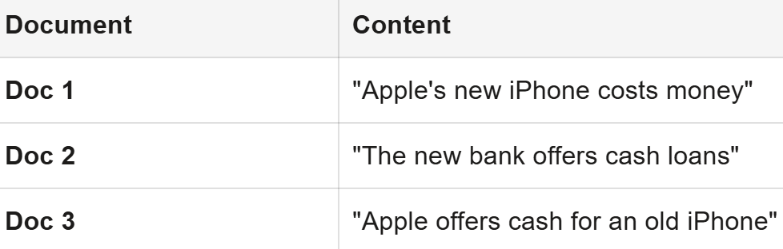
The Intuition of LDA (A Simplified Walkthrough)
Objective: Let's visualize how LDA discovers topics. We will act as the algorithm.
Our Mini-Universe:
Documents: We have three short documents.
Goal: We will tell the algorithm to find k=2 topics. Let's call them Topic A (Blue) and Topic B (Orange).

Slide 9
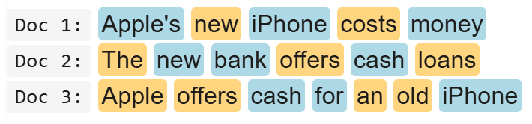
Step 1: Random Assignment
The algorithm starts by randomly assigning each word to a topic. The result is a meaningless mess.

Slide 10
Step 2: Iterative Improvement (The "Thinking" Part)
The algorithm iterates through every word. Let's pick the word "iPhone" in Doc 1. It asks two questions:
"Inside this document (Doc 1), what topic is most popular?"
  (Looking at Doc 1): It's a 3-2 split. Topic A (Blue) is slightly more common.
"Across ALL documents, what topic does the word 'iPhone' fit with best?"
  (Looking everywhere): The other "iPhone" in Doc 3 is Blue. Other words like "Apple's" are also Blue. The word 'iPhone' seems to belong with the Blue words.
Based on this, it's highly probable that "iPhone" should be Blue. The algorithm re-assigns it and moves to the next word. It does this thousands of times.

Slide 11
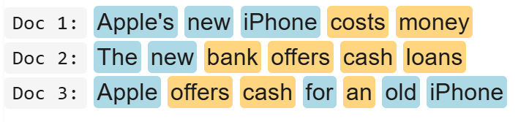
Step 3: Convergence
After many iterations, the assignments stabilize. Words that appear together end up in the same topic cluster.

Slide 12
Step 4: The Final Output
The algorithm presents two things:
The Topics (as word lists):
  Topic A (Blue): apple, iphone, new, ... (We interpret this as "Tech Products")
  Topic B (Orange): cash, money, bank, loans, offers, ... (We interpret this as "Finance")
The Document Mixture:
  Doc 1: is about 60% Topic A and 40% Topic B.
  Doc 2: is about 20% Topic A and 80% Topic B.
  Doc 3: is about 50% Topic A and 50% Topic B.
This simple demo perfectly illustrates how an unsupervised algorithm can take unstructured text and discover the hidden thematic structure within it.

Slide 13
Recap: Where We Left Off (Topic 7)
Last week, we mastered turning unstructured text into structured data.
Vectorization (Topic 7): We converted documents into numerical vectors using CountVectorizer and TfidfVectorizer.
NLP & Sentiment (Topic 8): We used TextBlob to analyze sentiment (Polarity) and discover topics with LDA.
We can represent a news headline like "Strong iPhone demand boosts Apple's revenue" as both a sentiment score (+0.5) and a TF-IDF vector ([0.0, 0.45, 0.0, 0.51, ...]).

Slide 14
The Limitations
Sentiment analysis is powerful, but it's a pre-built, general-purpose tool.
It tells us if a text sounds positive.
It doesn't learn from specific financial outcomes.
TextBlob doesn't know that the phrase "beat expectations" is highly correlated with a stock price increase the next day. It just knows "beat" can be a neutral or negative word.
The Challenge: How can we build a model that learns the relationship between the text of a news article and a real-world financial outcome (like the stock going up or down)?

Slide 15
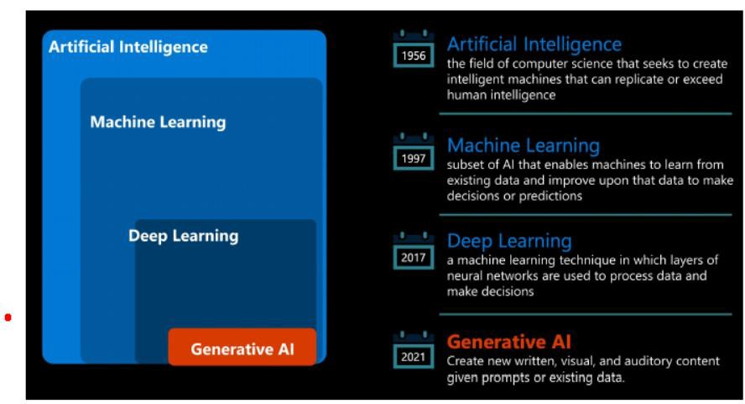
Artificial Intelligence

Slide 16
The Answer: Machine Learning (ML)
Machine Learning is a field of AI that gives computers the ability to learn from data without being explicitly programmed.
Instead of writing rules like if "beat expectations" in text: we can show the computer thousands of examples and let it figure out the patterns itself.
It's the bridge from describing data to making predictions.

Slide 17
Supervised vs. Unsupervised Learning
Unsupervised Learning (You've already done this!)
  The data has no labels. We ask the algorithm to find hidden structure.
  Analogy: Giving a person a box of mixed fruits and asking them to sort them into groups. They don't know the names "apple" or "orange," but they can cluster by color, shape, and size.
  Example from Week 8: Topic Modeling (LDA). We didn't tell the algorithm what the topics were; it discovered them.

Slide 18


What is it?
An algorithm uses training data and feedback from humans to learn the relationship of given inputs to a given output (eg, how the inputs “area” and “location” predict returns)
How it Works?
A human labels the input data (eg, in the case of predicting returns, labels the input data as “area,” “location” etc) and defines the output variable (eg, returns). The algorithm is trained on the data to find the connection between the input variables and the output. Once training is complete–typically when the algorithm is sufficiently accurate–the algorithm is applied to new data
When to use it?
You know how to classify the input data and the type of behaviour you want to predict, but you need the algorithm to calculate it for you on new data

Slide 19
Supervised Learning (Our focus today)
  The data is labeled. We have an input (X) and a known correct output (y).
  Analogy: Showing a child flashcards. You show a picture of an apple (X) and say "apple" (y). After many examples, the child can identify a new apple.
  Goal: Learn a "mapping function" that can predict the output (y) for a new, unseen input (X).

Slide 20
Supervised Machine Learning
Classification Models
Regression Models
To label historical data Transform into structured data
Using structured data to predict for the future

Slide 21
Supervised Learning: Classification vs. Regression
Within Supervised Learning, there are two main types of problems:
Classification: The output variable (y) is a category.
  Will this customer default on their loan? (Yes / No)
  Is this email spam or not spam?
  Does this news article belong to the "M&A" or "Earnings" category?
  Financial Application: Will the stock go Up or Down tomorrow?

Slide 22
Regression
Regression: The output variable (y) is a continuous value.
What will the price of this house be? ($500,000, $750,000...)
How many units will this product sell next quarter?
Financial Application: What will the exact stock price be tomorrow? ($150.23, $151.45.

Slide 23
The Core Machine Learning Workflow with Scikit-Learn
Introducing scikit-learn: The "Swiss Army Knife" for ML in Python.
  It provides a simple, consistent API for hundreds of models and tools.
  It integrates perfectly with pandas, NumPy, and matplotlib.
  !pip install scikit-learn

Slide 24
5 Step Process for supervised learning
Prepare Data: Separate data into features X (the inputs, must be numbers) and the target y (what you want to predict).
Split Data: Divide X and y into a training set and a testing set.
  Why? To simulate a real-world scenario. The model learns from the training set. We then evaluate its performance on the unseen testing set to get an honest assessment of how it will perform on new data.
  Analogy: The training set is the textbook and practice problems. The test set is the final exam. You can't use the final exam to study!
Choose & Train a Model: Select a model and use the .fit() method on the training data. This is where the "learning" happens.
Evaluate the Model: Use the trained model to make predictions ( .predict() ) on the test set and compare them to the true test labels to measure performance (e.g., accuracy, error).
Make Predictions: Use the final, trained model on new, live data to make real predictions.

Slide 25
Demo Exercise 1: A Simple Stock Price Prediction (Regression)
Objective: Use a simple regression model to predict a stock's next-day closing price based on its Open, High, and Low for the day. This is a very simple example, but it demonstrates the workflow perfectly.
Our Task:
Load historical stock data using yfinance.
Create our features (X) and target (y).
Split, train, and evaluate a LinearRegression model.
This output shows how well your model performed when it was asked to predict stock prices on the test data—the portion of data it had never seen during training. It gives you two perspectives:
An overall performance score (the RMSE).
A specific, concrete example to help you visualize that performance.

Slide 26
Recap on metrics
What is RMSE?
The "Root Mean Squared Error" is a standard way to measure the error of a model that predicts continuous numbers (like a stock price). In simple terms, it represents the typical distance between the prices your model predicted and the actual prices.

Slide 27
Explanation on the ouputs
What does the number $3.64 mean?
This is the most important part. It means that on average, your model's predictions were off by about $3.64.
Think of it like a weather forecast that predicts the temperature. If the forecast predicts 25°C and the actual temperature is 27°C, the error is 2°C. The RMSE is the typical size of that error across all the days in your test set.
Is $3.64 good or bad?
The answer is always, "It depends on the context." An error of $3.64 on a stock that trades for $10 is terrible. But on a stock that trades for $130 (like Apple in this period), it's an error of roughly 2.8% (3.64 / 128.00). For a very simple model using only the previous day's price data, this is a reasonable starting point. A professional quantitative analyst would aim to get this number much, much lower.
In short: The RMSE gives you the average "margin of error" for your model's predictions.

Slide 28
More Explanation
What is this?
While the RMSE gives you the average error over many days, this section zooms in on a single day—the very last day of your test data. It shows you one specific instance of your model in action.
What does it tell us?
  The Actual Price was $128.00. This is the real, historical closing price for that day.
  Your Model's Predicted Price was $128.95. This is what your model forecasted the price would be, based on the Open, High, Low, and Close from the day before.
Connecting it to the RMSE:
On this particular day, the model's error was $0.95 ($128.95 - $128.00). This single error is smaller than the average error of $3.64. This is perfectly normal! Just like with a weather forecast, some days the prediction will be very close, and other days it will be further off. The RMSE of $3.64 is the typical error when you average out all these good and bad prediction days.

Slide 29
The Interpretation would be…
"We built a Linear Regression model to predict Apple's next-day closing price. When evaluated on unseen data, the model had a Root Mean Squared Error of $3.64, meaning its predictions were typically off by that amount. For example, on the last day of our test period, the actual price was $128.00, and our model predicted $128.95, an error of just $0.95 on that day."

Slide 30
Your simple exercise 1
Visualizing Model Performance
Objective:
A single number like RMSE tells us the average error, but it doesn't show us where or when our model is making mistakes. A visual plot is one of the most powerful tools for understanding a model's behavior.

Slide 31
Your Task 1
To create a professional line chart that compares your model's predicted stock prices against the actual stock prices. This will help you visually assess the strengths and weaknesses of your model. (you can use matplotlib)

Slide 32
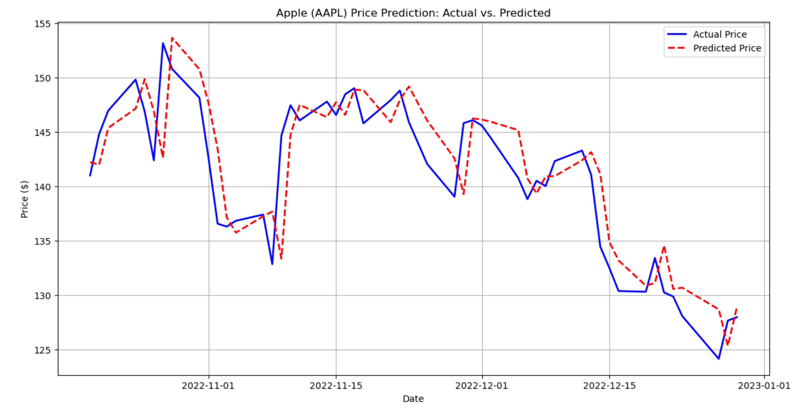
Your Task 1

Slide 33
Task 2: Discussion Questions
After creating your plot, answer these questions by looking at your chart:
Does the "Predicted Price" line generally follow the trend of the "Actual Price" line?
Are there specific periods (e.g., a sharp drop or rise) where the model's predictions seem to lag behind the actual price?
Based on the visualization, what is the biggest weakness of this simple model? (Hint: How does it react to sudden changes?)

Slide 34
Answers
1. Does the "Predicted Price" line generally follow the trend of the "Actual Price" line?
Answer: Yes, absolutely.
The red "Predicted Price" line does a good job of following the overall trend of the blue "Actual Price" line. When the actual stock price is in a general upward trend over several days, the model's predictions also trend upward. When the actual price trends down, the predictions follow suit.
Why this happens: Our model is a LinearRegression model that uses the previous day's Open, High, Low, and Close prices to predict the next day's Close. Stock prices have high "autocorrelation," which is a fancy way of saying that today's price is usually very close to yesterday's price. The model learns this fundamental rule: "The price tomorrow will likely be very near the price today." This allows it to capture the general direction of the market.

Slide 35
Answers
2. Are there specific periods (e.g., a sharp drop or rise) where the model's predictions seem to lag behind the actual price?
Answer: Yes, this is one of the most obvious takeaways from the chart. The model's predictions consistently lag behind the actual price by one day.
When there's a sharp drop: Look at any day where the blue line drops suddenly. You will see that the red line (the prediction) for that same day is still high. The red line only drops on the next day, after it has seen the low price from the day before.
When there's a sharp rise: The same thing happens in reverse. If the stock has a surprisingly good day, the model will not predict it. It will only predict a higher price for the day after the jump occurred.
Why this happens: The model has no "crystal ball." Its entire knowledge base for predicting a given day's price comes from the previous day's data. It cannot know about a surprise news event or a sudden shift in market sentiment that will happen today. It is always looking in the rearview mirror, which causes this characteristic one-day lag.

Slide 36
Answers
3. Based on the visualization, what is the biggest weakness of this simple model?
Answer: The model's biggest weakness is its inability to predict volatility and sudden changes.
The visualization makes this weakness clear:
It smooths out the price: The actual price (blue line) is jagged and volatile, with many small and large daily ups and downs. The predicted price (red line) is much smoother. The model is essentially averaging out the potential movements and is too conservative to predict a large jump or drop.
It fails at turning points: The model is at its worst when the market changes direction. It will continue predicting a rise even on the first day of a drop, and vice versa. It's always one step behind.
Why this happens: This model is too simple. It only knows about the price from the day before. It has no information about market sentiment, trading volume spikes, news headlines, or broader economic indicators. Without this richer context, it cannot possibly anticipate a sudden change; it can only react to it after the fact. In the real world, predicting changes in trend (the volatility) is where the real value lies, and this model completely fails at that.

Slide 37
Demo Exercise 2: Introduction to ML Classification
Objective:
In the previous exercise, we predicted a number (a stock price). Now, we will predict a category. This is called classification.
Our goal is to build a model that can predict whether a breast tumor is malignant (cancerous) or benign (not cancerous) based on real medical measurements from tumor cells.
The Model: We will use Logistic Regression, which is the "Hello, World!" of classification models. Despite its name, it's used for classification, not regression. It works by learning a boundary to separate the different categories.

Slide 38
Step 1: Setup and Data Loading
First, let's import the libraries we need and load our dataset. We will use the "Wisconsin Breast Cancer" dataset, which is conveniently included with scikit-learn.
Code: We've loaded a dataset with 30 different measurements (like mean radius, mean texture, etc.).
The target column is our goal. It contains a 0 if the tumor was malignant or a 1 if it was benign. This is the category we want our model to predict.

Slide 39
Step 2: Prepare the Data for Modeling
Just like in regression, we must separate our data into features (X)—the data we use to make a prediction—and the target (y)—what we are trying to predict.
Then, we'll split them into a training set (for the model to learn from) and a test set (to evaluate its performance on unseen data).
The machine learning process remains the same: we have features (X_train) and answers (y_train) for the model to study. Later, we will give it the test features (X_test) and see if its predictions match the real answers (y_test).

Slide 40
Step 3: Train the Classification Model
Now we create an instance of our LogisticRegression model and train it using the .fit() method on our training data.
During the .fit() process, the model analyzed the 30 features for all the tumors in X_train and learned the patterns that tend to separate malignant tumors (0) from benign ones (1).

Slide 41
Step 4: Evaluation
For classification, we can't use RMSE. An error of "0.5" doesn't make sense when the answers are categories. Instead, we use different metrics.
Accuracy Score
The simplest metric is accuracy: What percentage of the time did the model guess the correct category?
An accuracy of 0.9561 means the model correctly classified 95.61% of the tumors in the test set it had never seen before. This sounds very good!

Slide 42
Step 4: Evaluation
B. The Confusion Matrix
Accuracy is useful, but it doesn't tell the whole story. What kind of mistakes is the model making? A Confusion Matrix gives us a more detailed look. It's a table that shows:
How many times did we predict Benign and it was actually Benign? (True Positive)
How many times did we predict Malignant and it was actually Malignant? (True Negative)
How many times did we predict Benign but it was actually Malignant? (False Positive - A very dangerous mistake!)
How many times did we predict Malignant but it was actually Benign? (False Negative)

Slide 43
Confusion Matrix
How to Read the Confusion Matrix:
Top-Left (True Negative): The model correctly predicted 39 tumors were malignant.
Bottom-Right (True Positive): The model correctly predicted 70 tumors were benign.
Top-Right (False Positive): The model incorrectly predicted 4 malignant tumors were benign. This is the most dangerous error in a medical context.
Bottom-Left (False Negative): The model incorrectly predicted 1 benign tumors were malignant. This would cause unnecessary stress for a patient but is less dangerous than a missed cancer diagnosis.
Conclusion:
This simple classification model performs remarkably well, with over 95% accuracy. However, the confusion matrix reveals that it still makes a few critical errors, highlighting the need for more advanced models and careful evaluation in real-world medical applications.

Slide 44
Capstone Exercise (in Class Submission)
Predicting Medical Insurance Costs
Scenario:
You are a junior data scientist at a health insurance company. Your manager wants to understand what factors influence a person's medical costs and wants you to build a model to predict these costs for new customers. This will help the company set fair prices for their insurance plans.
You have been given a dataset containing information about past customers.
https://raw.githubusercontent.com/stedy/Machine-Learning-with-R-datasets/master/insurance.csv
Your Mission:
From start to finish, you will load, analyze, and model this data. You will build one regression model (part 1) to predict the exact insurance cost and one classification model (part 2) to predict whether a person is a smoker. You will then evaluate and compare your models.

Slide 45
Hints (1) – Part 1
Load the Data:
  The dataset is available directly through a public URL. Load it into a pandas DataFrame.
import pandas as pd url = 'https://raw.githubusercontent.com/stedy/Machine-Learning-with-R-datasets/master/insurance.csv' df = pd.read_csv(url)
Initial Data Inspection:
  Display the first 5 rows (.head()).
  Use .info() to check for missing values and see the data types of each column.
  Use .describe() to get statistical summaries of the numerical columns (age, bmi, children, charges).
Handle Categorical Data:
  Our models need numbers, not text. The columns sex, smoker, and region are categorical. We need to convert them
4. Define Features (X) and Target (y):
  The target y is the charges column.
  The features X will be all other columns in your df_processed DataFrame.
5. Split the Data:
  Split your data into training and testing sets (X_train, X_test, y_train, y_test). Use a test_size of 0.2 and a random_state of 42 for consistency.
6. Train a Regression Model:
  Import LinearRegression from sklearn.linear_model.
  Create an instance of the model and train it on your training data (.fit()).
7. Evaluate the Regression Model:
  Make predictions on your X_test data.
  Import and calculate the Root Mean Squared Error (RMSE) to see, on average, how far off your predictions were in dollars.

Slide 46
Hints (2) – Part 2
1. Define Features (X) and Target (y):
  The target y is now the smoker_yes column.
  The features X will be all other columns in df_processed, but be careful not to include charges. Why? Because charges is heavily influenced by smoking, including it would be like giving the model the answer!
2. Split the Data:
  Split this new X and y into training and testing sets, again using test_size=0.2 and random_state=42.
3. Train a Classification Model:
  Import LogisticRegression from sklearn.linear_model.
  Create and train the model on your new training data.
4. Evaluate the Classification Model:
  Make predictions on your test set.
  Calculate the accuracy score.
  Generate and display a confusion matrix to see what kind of errors your model is making.

